Slide 1

DECISION MAKER BASH SCRIPT
INTEGRAL UNIVERSITY , LUCKNOW
(DEPARTMENT OF COMPUTER SCIENCE & ENGINEERING)
PRESENTED BY:
ANJALI SINGH
ROLL NO: 1601012028
AMINA SHAHEEN
ROLL NO:1601012022
(CSE -1; YEAR- 4)

Slide 2
WHAT IS A BASH SCRIPT?
A Bash script is a plain text file which contains a series of commands. These commands are a mixture of commands we would normally type ourselves on the command line (such as ls or cp for example).

Slide 3
WHAT DOES BASH SCRIPT DO?
Bash is a type of interpreter that processes shell commands. A shell interpreter takes commands in plain text format and calls Operating System services to do something.
A shell scripting is writing a program for the shell to execute and a shell script is a file or program that shell will execute.
We use these commands in a terminal which is the interface to the shell interpreter.

Slide 4
A shell script is a fully-fledged programming language in itself.
It can define variables, functions and we can do conditional execution of shell commands as well.
Having a terminal at your disposal can save precious time and sometimes GUI of your OS might not provide the necessary tool to perform actions such as executing a binary file with options.

Slide 5
DECISION MAKER BASH SCRIPT (AIMS AND OBJECTIVES):
The main aim of Decision maker bash script which can be used by any application developer to calculate the shortest path using basic data structure in a dynamic environment. This problem has many useful applications. The routing protocols used in most of today’s computer networks are based on shortest path algorithms. Machine learning on graphs is a young but growing field.

Slide 6
Neural networks are a way to create functions that no human could write. They do this by harnessing the power of large datasets. On problems for which we have capable neural models, we can use example inputs and outputs to train the network to learn a function that transforms those inputs into those outputs, and hopefully generalizes to other unseen inputs. We need to be able to build neural networks that can learn functions on graphs. Those neural networks need the right inductive biases so that they can reliably learn useful graph functions. With that foundation, we can build powerful neural graph systems.

Slide 7
HARDWARE AND SOFTWARE SPECIFICATION
Software Requirements:-
C++
Connector/C++
MySQL
Hardware Requirements
Pentium IV Processor
1GB RAM
10 GB HDD
Color Monitor
Keyboard, Mouse
Operating System
Linux-Unix operating system.

Slide 8
The Decision maker bash script consists of following modules:
JSON PARSER
It takes raw data in form of a JSON file as an input and then populates the database.
GRAPH CREATOR
It creates a graph according to the tables in the database. The output from the first module JSON PARSER is taken as an input after which a Graph as an output is generated.
FARE CALCULATOR
It calculates the minimum fare between two cities using the shortest path algorithm. After having the graph data structure it generates the best path between source and destination.

Slide 9
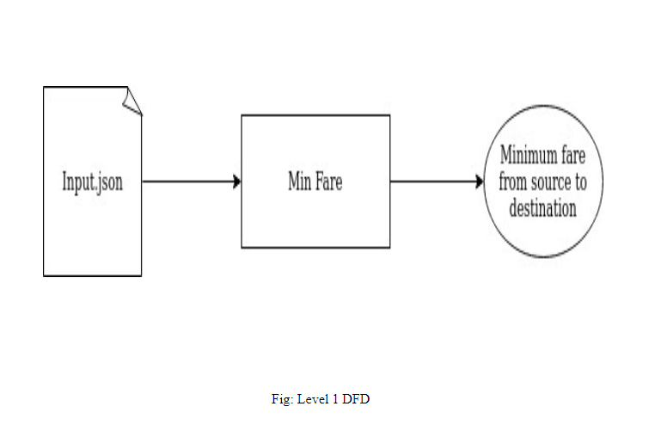
Data Flow Diagram

Slide 10
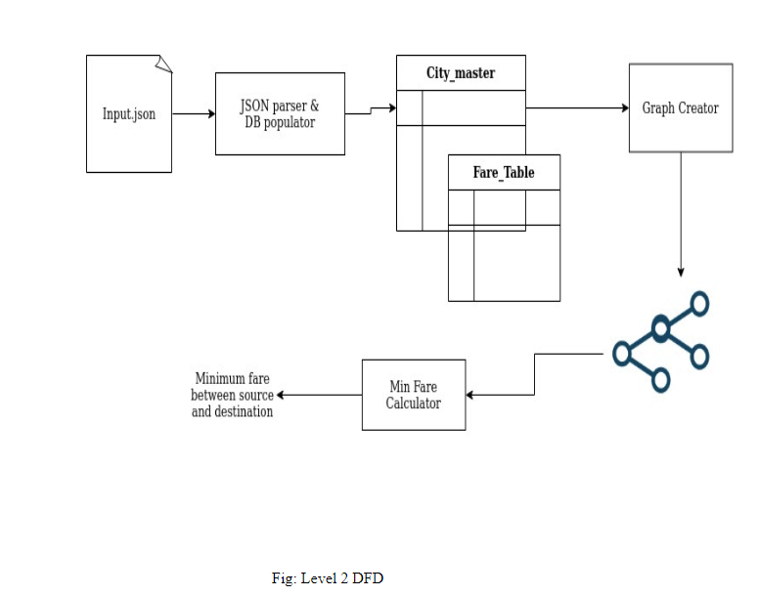
Level-2 DFD

Slide 11
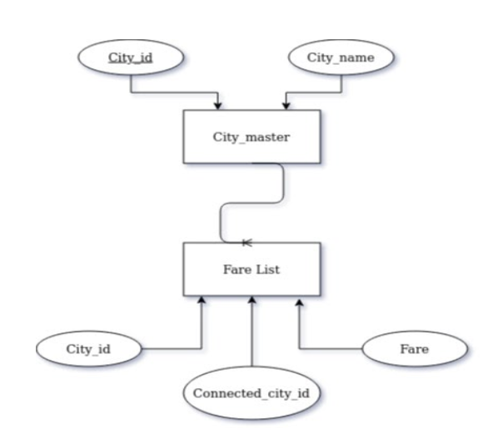
Entity Relationship Diagram

Slide 12
WORKING:
In this Decision Maker Bash Script , first we have raw data.
The raw data is extracted using ETL(Extract, Transform and Load).
Data extraction involves extracting data from homogeneous or heterogeneous sources; data transformation processes data by data cleansing and transforming them into a proper storage format/structure for the purposes of querying and analysis; finally, data loading describes the insertion of data into the final target database such as an operational data store, a data mart, data lake or a data warehouse

Slide 13
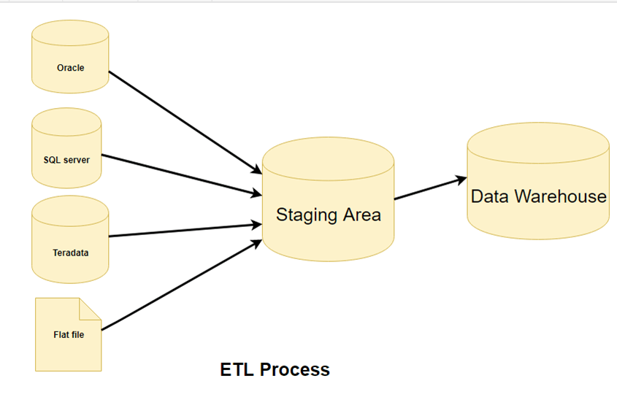

Slide 14
This extracted data is converted into C-based script.
This script is then loaded into database and the required information is extracted.
This data is then converted into data structure and finally this is processed to get the final result.

Slide 15
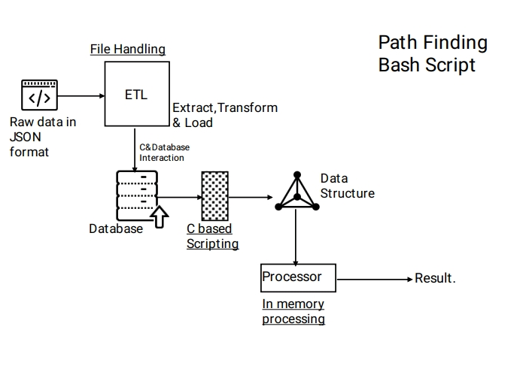

Slide 16
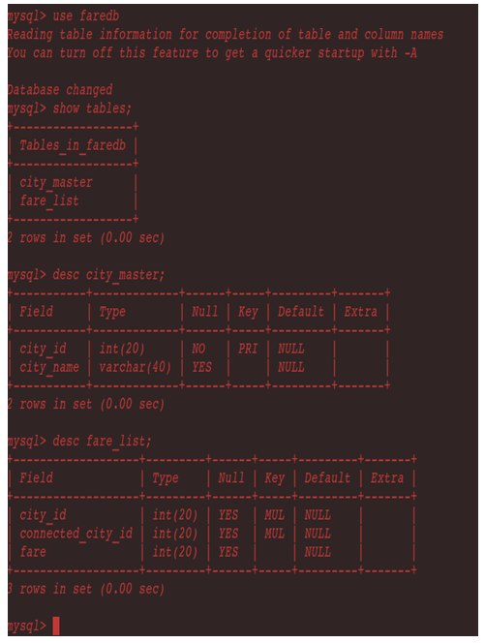
Database Tables(Snapshot)

Slide 17
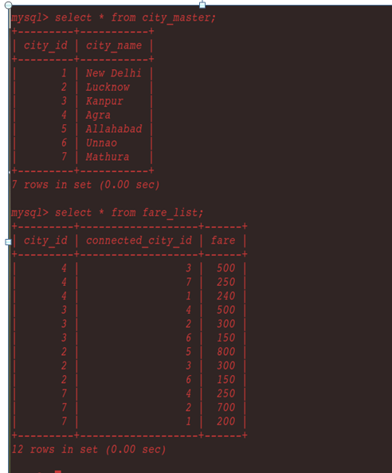

Slide 18
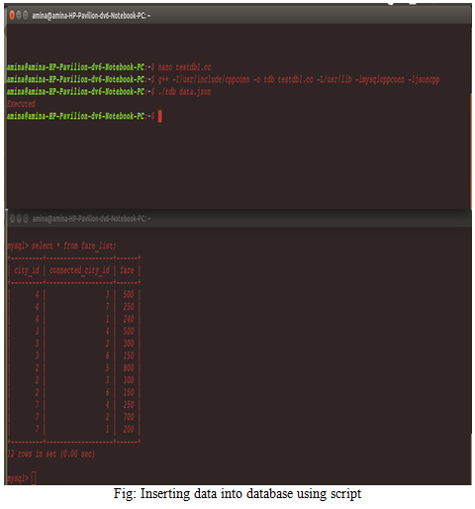

Slide 19
SDLC MODEL USED:
This project “Decision Maker” is based on Agile process model.
The meaning of Agile is swift or versatile.
"Agile process model" refers to a software development approach based on iterative development.
Agile methods break tasks into smaller iterations, or parts do not directly involve long term planning.
In this project, the project scope and requirements are laid down at the beginning of the development process. Plans regarding the number of iterations, the duration and the scope of each iteration are clearly defined in advance.

Slide 20
The division of the entire project into smaller parts helps to minimize the project risk and to reduce the overall project delivery time requirements.
Each iteration involves a team working through a full software development life cycle including planning, requirements analysis, design, coding, and testing before a working product is delivered.

Slide 21
PHASES:
Following are the phases in the Agile model upon which our project is based:
Requirements gathering
Design the requirements
Construction/ iteration
Testing/ Quality assurance
Deployment
Feedback

Slide 22
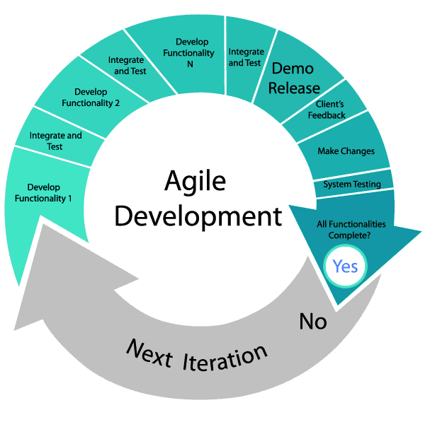

Slide 23
TESTING METHOD:
The testing method used to test this project is MANUAL TESTING.
Manual Testing is a process in which we compare the behavior of a developed piece of code (software, module, API, feature, etc.) against the expected behavior (Requirements).
Manual Testing is a process of finding out the defects, bugs in a software program. A tester perform end user role and verifies if all the features are working properly or not. Tester manually executes the test cases.

Slide 24
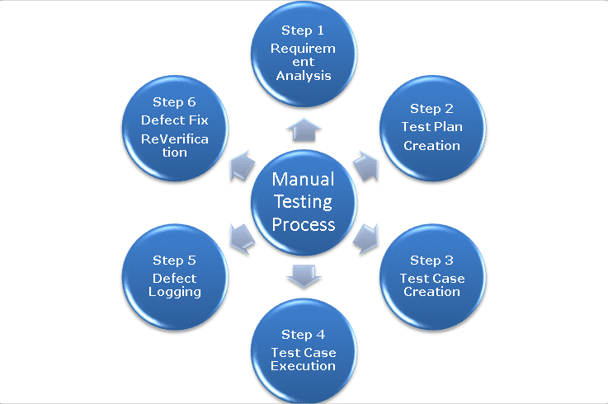

Slide 25
Conclusion
A bash script which can be used by any application developer to calculate the shortest path using basic data structure in a dynamic environment. This problem has many useful applications. The routing protocols used in most of today’s computer networks are based on shortest path algorithms. Machine learning on graphs is a young but growing field.

Slide 26
Future Scope
The shortest path algorithm can also be used in deep learning where the algorithm will work faster because it will use heuristics to make more educated guesses about which route is the smallest.
To overcome the limitations of this script a more efficient heuristic function can be developed. This newly designed script can be modified so that it always returns the shortest path possible

Slide 27
References
Websites:
www.google.co.in
www.json.org/json-en.html
www.geeksforgeeks.org
www.wikipedia.com
www.tutorialspoint.com
www.udemy.com
www.w3schools.com
www.codeforces.com
www.mysql.com
https://dev.mysql.com
https://linux.tips/
https://subscription.packtpub.com
https://github.com/Microsoft/vcpkg
Books:
C++ PRIMER
INTRODUCTION TO ALGORITHMS BY THOMAS H. CORMEN
DATABASE SYSTEM CONCEPTS
JAVASCRIPT-JSON-COOKBOOK
DATA STRUCTURES AND ALGORITHMS MADE EASY BY NARASIMHA KARUMANCHI

Slide 28
THANK YOU……

